Slide 1
Predicting the Income Bracket of a person using US Census Data
AJITESH SARANATH K - 19BCE1558

Slide 2
INTRODUCTION
We researched on many Large Scale Data Processing focused scientists/industry experts interviews where some of them answered for the question what would be their first project if they are a newbie in the field now?, for which many of them answered as a country’s census data(especially US one as it had a good amount of data init without many irregularities or uncertainty) as the dataset was huge as well as we can get to know the basics of the four of the popular algorithms that they as data scientist use in most of their prediction related data analyses.

Slide 3
ABSTRACT
From the various features in the census data set our aim is to build a predictive model to determine whether the income level for the people in United States exceeds the bracket of $50,000.

Slide 4
Our project is predicting the Income Bracket of a person from the dataset we have downloaded, we will progress in the project by following the given steps below:
1. We will clean the data (ie) some values may not be there in the data set and maybe left blank, we substitute 0 in those blank spaces.
2. We generate the plots for the data set.

Slide 5
METHODS
We use four predictive analysis algorithms on the data set:
• Logistic Regression.
• Decision Tree.
• Random Forest Classifier.
• k-Nearest Neighbours.

Slide 6
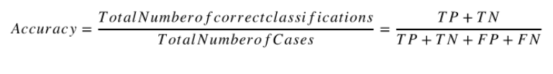
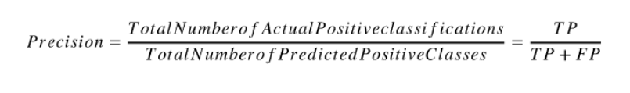
FOR PREDICTION AND ACCURACY
We use the following formula’s

Slide 7
LOGISTIC REGRESSION
Logistic regression is a statistical model that in its basic form uses a logistic function to model a binary dependent variable, although many more complex extensions exist. In regression analysis, logistic regression is estimating the parameters of a logistic model (a form of binary regression).

Slide 8
DECISION TREE
A decision tree is a flowchart-like structure in which each internal node represents a "test" on an attribute (e.g. whether a coin flip comes up heads or tails), each branch represents the outcome of the test, and each leaf node represents a class label (decision taken after computing all attributes). The paths from root to leaf represent classification rules.

Slide 9
RANDOM FOREST CLASSIFIER
Random forest, like its name implies, consists of a large number of individual decision trees that operate as an ensemble. Each individual tree in the random forest spits out a class prediction and the class with the most votes becomes our model’s prediction.

Slide 10
k-NEAREST NEIGHBOURS
K-nearest neighbors (kNN) is a supervised machine learning algorithm that can be used to solve both classification and regression tasks.The value of a data point is determined by the data points around it.

Slide 11
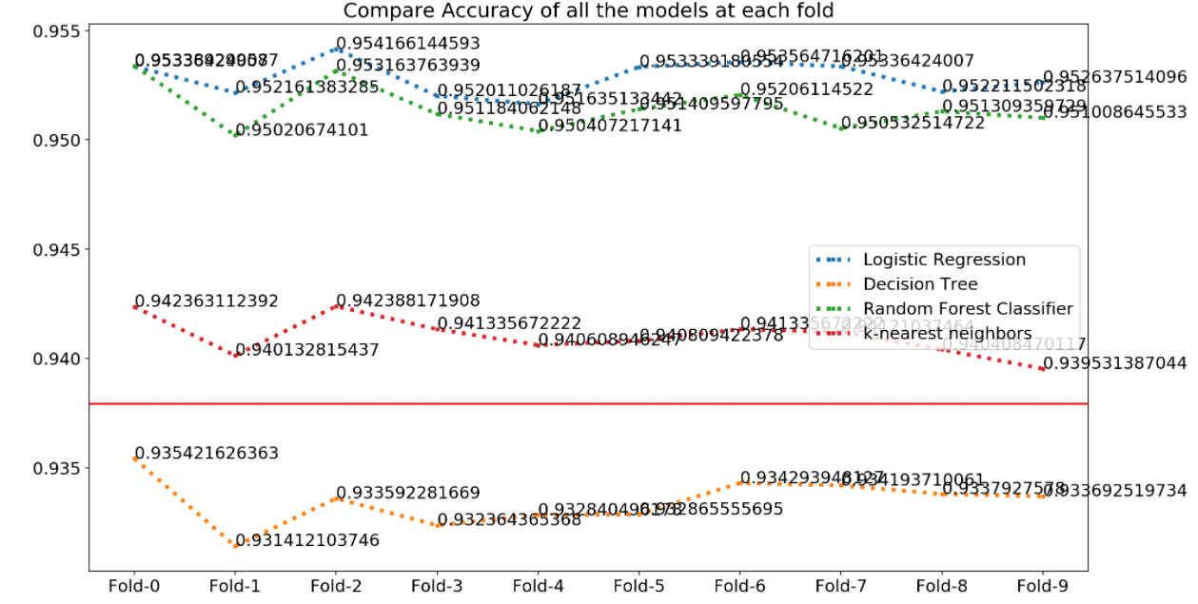
IMPLEMENTATION
Accuracy

Slide 12
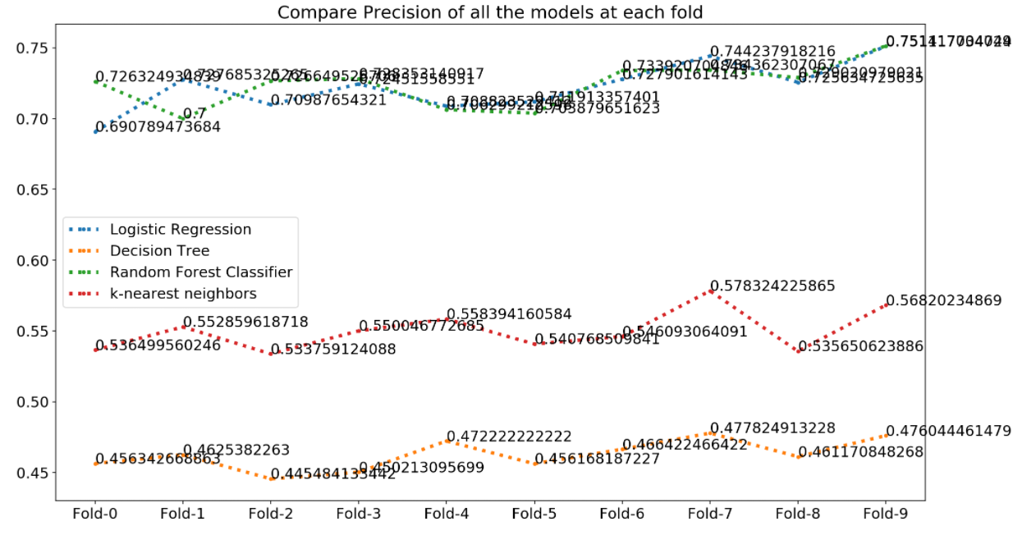
Precision

Slide 13
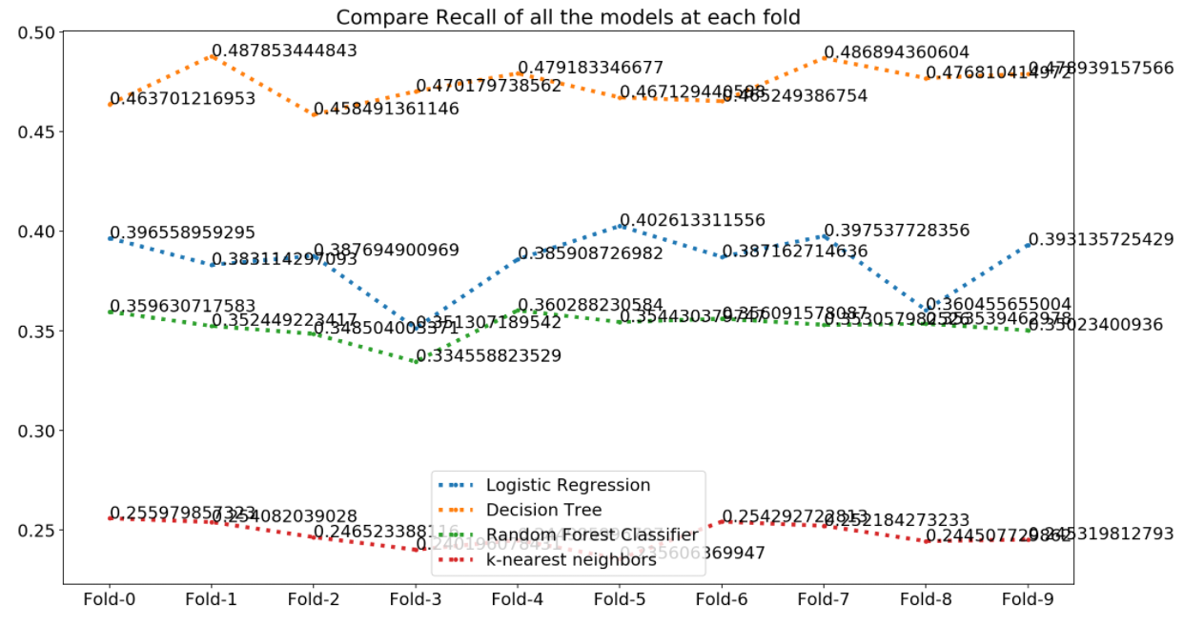
Recall

Slide 14
SUMMARY
Accuracy
Out of all the models we used for classification all the accuracy score beats the baseline we set earlier, except of Decision Tree, whose accuracy is 93.3662%, which is slightly less than what we expected from our model to perform. Apart from decision tree all the models seems to do a good job of classyfying the outcomes, which is great
Precision
If our precision score is 0.61454525 (which is our average precision score for all the models) this says that if our classifier predicts someone to have an income below 50K is right about 61.45% of the time. This is not bad because the number of population with income more than 50k are fewer than that of less than 50K
.

Slide 15
RESULT
From the previous implementation we can conclude that Logistic Regression has the highest accuracy and Decision Tree has the highest prediction % between the four different prediction models.

Slide 16
REFERENCES
https://youtu.be/yIYKR4sgzI8
https://www.researchgate.net/post/How_to_find_the_metrics_for_cross_folds_validation_process
https://royalsocietypublishing.org/doi/10.1098/rsta.2015.0202#:~:text=Principal%20component%20analysis%20(PCA)%20is,variables%20that%20successively%20maximize%20variance.
https://www.academia.edu/40002493/ADULT_CENSUS_INCOME_PREDICTION_USING_RANDOM_FOREST_120190803_5870_1c0u9b8

Slide 17
THANK YOU

